Slide 1
Stepping Stone Detection Uncovering the Hidden
Michael Gibson
Aditya Manocha
Notes:
Security classification options: – Public
– Internal
– Confidential
– Highly Confidential

Slide 2
Background
Collaboration with University of Edinburgh
PhD student (Henry Clausen) looking into anomaly detection in networks
“Semantic Modelling of Network Traffic for Anomaly Detection”
Summer placement last year looking into “Stepping Stones”
BT Security (Jake Hill and Peter Walker) noticed “proxies” were being used to route private traffic
By treating a proxy as a stepping stone, we can look into applying recently developed detection methods to real-world problems

Slide 3
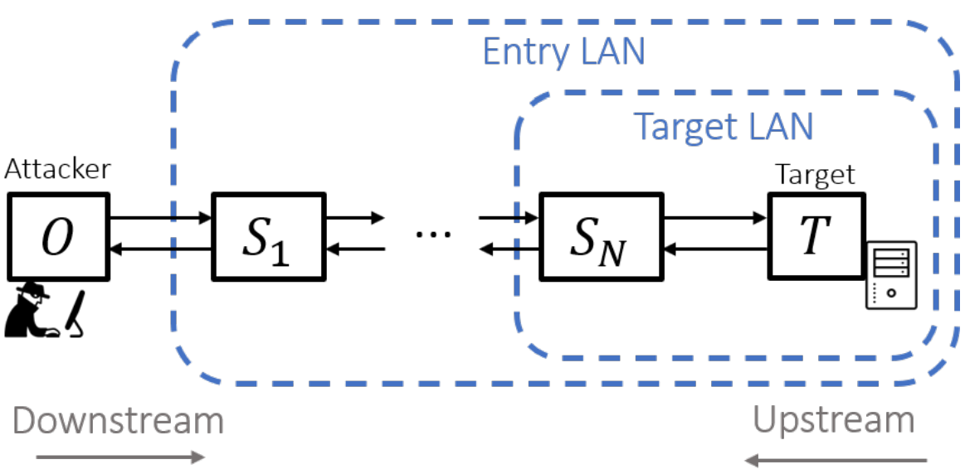
Background
Stepping stones are intermediary computers to relay commands between an attacker and a target whilst minimising detection
Typically a series of (SSH) tunnels between pairwise computers
Detection through the use of watermarking and measuring round-trip times
Evasion through packet delays and chaff

Slide 4
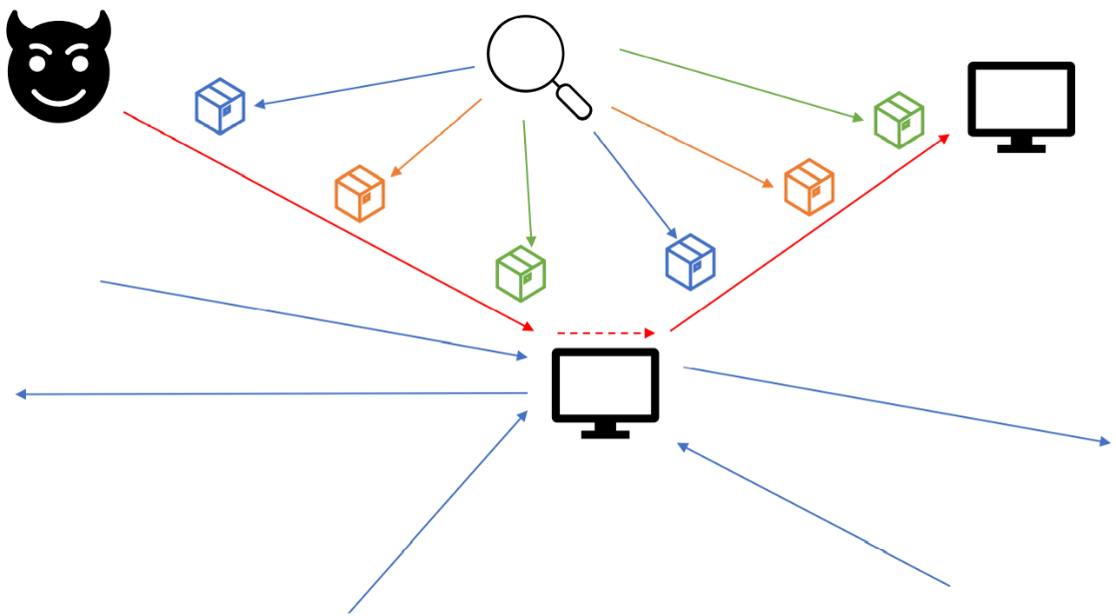
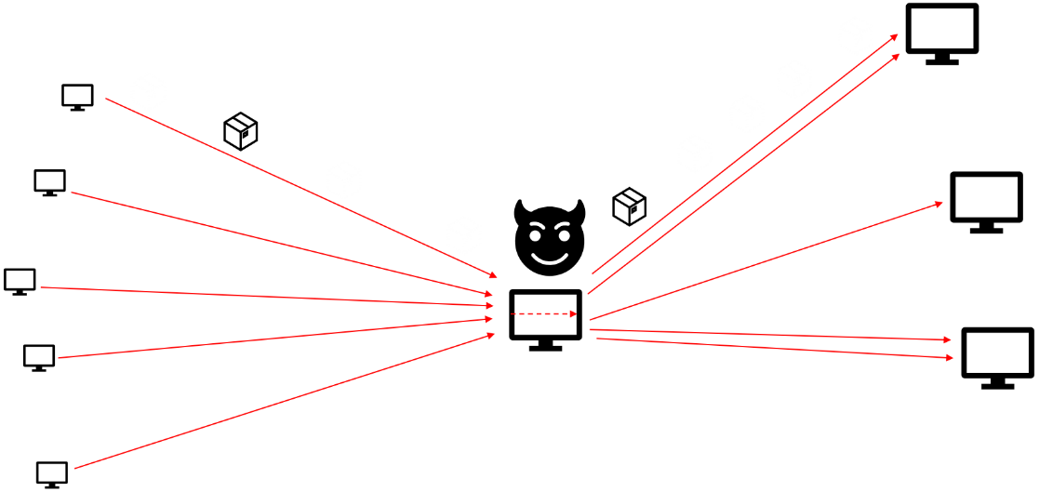
Proxies
Variation of a stepping stone where an intermediary computer relays content to other computers
Usage in illegal activities
DNS resolving private IPs
Streaming copyrighted material
Hard to detect more complex content with traditional packet analysis, so what can be done?

Slide 5
Access to Datasets
Publicly available datasets lack realism and do not contain ground truth labels about the nature of interaction
Examples of proxying in BT Security, but access is restricted due to data sensitivity
Next best approach is to replicate the environment to generate our own data
Any models created using this data should be compatible with production environments

Slide 6
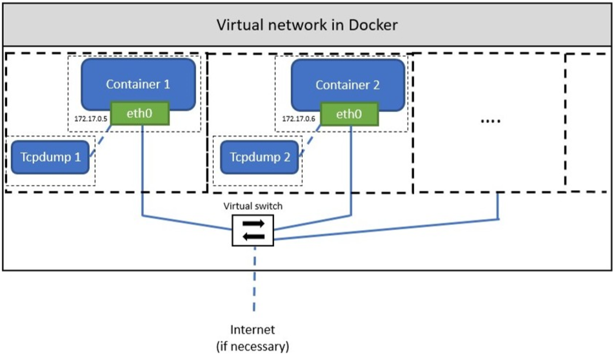
Initial Setup: Detgen Framework
Henry came up with the Detgen framework using Docker containers to establish ground truth
Controlled and Isolated network traffic generation from a variety of applications and tasks
Containers acting as sandboxed OS running different programs
Communication possible among containers via the virtualized network

Slide 7
Short-Comings with the Detgen Framework
Capturing only possible per container
Difficulty in capturing full flow of traffic relayed between containers (e.g. Container 1 -> Container 2 -> Container 3)
Establishing correct timestamps of traffic flows between the containers in case of separate captures done per container

Slide 8
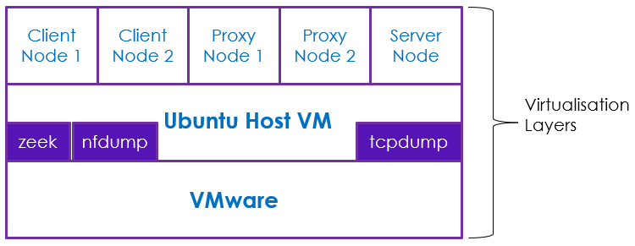
Setting up Virtual Machine on VMware
Building on the same concept of Detgen framework
Ubuntu deployed on VMware with 5 Linux containers implemented over it with capability of inter-communications
Linux Containers acting as: Client Node-1, Client Node-2, Proxy Node-1, Proxy Node-2, Server Node
Squid Proxy installed and configured on both Proxy Nodes acting as traffic relay nodes
Nginx Web Server installed on Server Node to respond to custom HTTP requests
Host Ubuntu VM able to capture all communications between the nodes
Zeek and nfdump installed on the host VM generates real-time logs for later analysis

Slide 9
Setting up Virtual Machine on VMware (contd.)
IP link setup on the Server Node with 10.10.0.0/16 subnet
Configuring clients and proxy nodes to reach server using any of the IP address in 10.10.0.0/16 subnet
Scripting Client HTTP requests to random IPs in the above subnet range
Configuring Nginx on server node to respond back with a random HTTP response for every HTTP GET request to make each response different and unique to make better correlations
Client Node 1
Proxy Node 1
Proxy Node 2
Server Node
Client Node 2

Slide 10
Short-comings with the VM setup
Connection size was limited and relatively small compared to real life
Connections terminated after one request and response
Bytes transferred from server back to the client were not very different and were in the range of 600 to 700 bytes
Response times were quick as they were scripted
Flows were compact

Slide 11
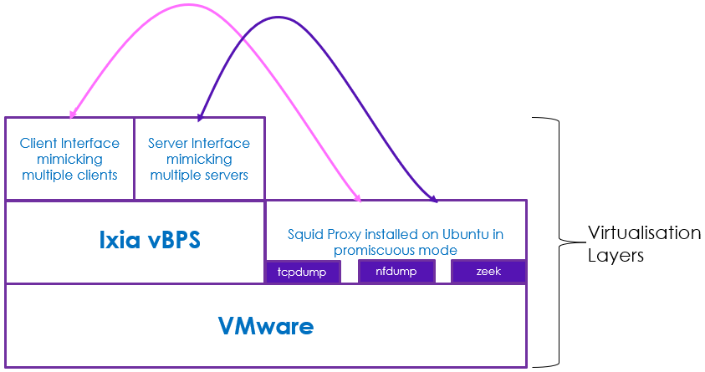
Next Steps: Using Ixia vBPS
Will potentially solve the problem of session sizes and durations
Flexibility around generation of more complex application flows
Custom configuration for request and response sizes
One or more proxies can be deployed between the two Ixia interfaces to create a similar implementation as with the previous approach
Easy to mix the ground truth stepping stone flows with benign traffic flows not relayed via the proxies

Slide 12
End Goal
Generated traffic flow data to be used in a deep-learning framework to detect proxied traffic
Detecting (multiple) relays from a proxy and unusual access to private content
Usage of DeepCorr (Nasr et al., 2018), a CNN for detecting correlations in upstream and downstream traffic
Developed on Tor data, but has been applied to classic stepping stones
Data generation suite for different types of applications and protocols

Slide 13
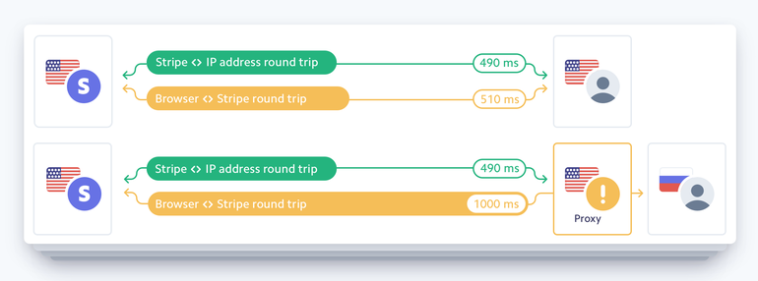

Server-side proxy-detection techniques
Mostly for benign proxies
Header analysis
IP/GEO-location info extraction
SSL-ciphers
Port-distribution/WIMIA test
Content watermarking
Notes:
A common technique to detect stepping-stones is Watermarking, where a bitstring is actively embedded in the first packet stream by altering packet interarrival times. This watermark is then detected in the forwarded packet stream
Another popular technique is packet correlation, where similar packets that occur in both streams are matched through their size, timing, and other metadata, and accumulated as evidence of a relay.
Furthermore, some methods attempt to measure excessive round-trip-time in a connection, a characteristic of relayed connections.

Slide 14
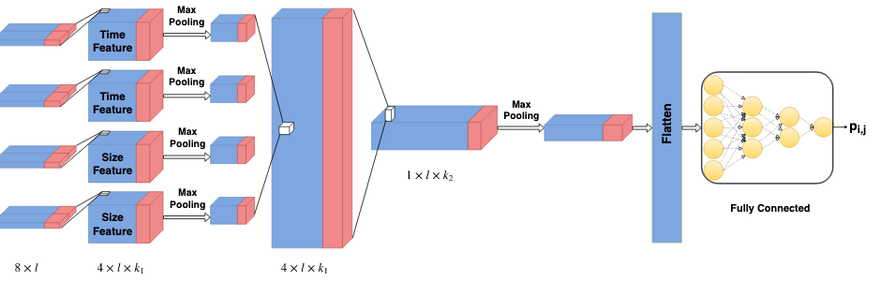
Stepping-stone detection
Most common techniques:
Watermarking
Packet correlation
RTT-based
Flow 1
Flow 2
Flow 1
Flow 2
Flow 1
Flow 2
Notes:
A common technique to detect stepping-stones is Watermarking, where a bitstring is actively embedded in the first packet stream by altering packet interarrival times. This watermark is then detected in the forwarded packet stream
Another popular technique is packet correlation, where similar packets that occur in both streams are matched through their size, timing, and other metadata, and accumulated as evidence of a relay.
Furthermore, some methods attempt to measure excessive round-trip-time in a connection, a characteristic of relayed connections.

Slide 15
Stepping-stone detection
Most common techniques:
Watermarking
Packet correlation
RTT-based
Designed for
Individual connections
robustness against evasion
full packet capture
Notes:
A common technique to detect stepping-stones is Watermarking, where a bitstring is actively embedded in the first packet stream by altering packet interarrival times. This watermark is then detected in the forwarded packet stream
Another popular technique is packet correlation, where similar packets that occur in both streams are matched through their size, timing, and other metadata, and accumulated as evidence of a relay.
Furthermore, some methods attempt to measure excessive round-trip-time in a connection, a characteristic of relayed connections.

Slide 16
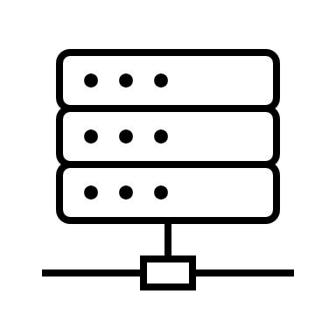







Potentially suitable techniques
Identifying exact packet-content matches
Statistical tests on the similarities of total incoming and outgoing stream
Average byte per flow
Average byte per hour
Time-correlation in activity levels
Port entropy anomalies
Training a correlation LSTM/CNN
Notes:
A common technique to detect stepping-stones is Watermarking, where a bitstring is actively embedded in the first packet stream by altering packet interarrival times. This watermark is then detected in the forwarded packet stream
Another popular technique is packet correlation, where similar packets that occur in both streams are matched through their size, timing, and other metadata, and accumulated as evidence of a relay.
Furthermore, some methods attempt to measure excessive round-trip-time in a connection, a characteristic of relayed connections.

Slide 17

Potentially suitable techniques
Activity
Benign Act.
Identifying exact packet-content matches
Statistical tests on the similarities of total incoming and outgoing stream
Average byte per flow
Average byte per hour
Time-correlation in activity levels
Port entropy anomalies
Training a correlation LSTM/CNN
Notes:
A common technique to detect stepping-stones is Watermarking, where a bitstring is actively embedded in the first packet stream by altering packet interarrival times. This watermark is then detected in the forwarded packet stream
Another popular technique is packet correlation, where similar packets that occur in both streams are matched through their size, timing, and other metadata, and accumulated as evidence of a relay.
Furthermore, some methods attempt to measure excessive round-trip-time in a connection, a characteristic of relayed connections.

Slide 18
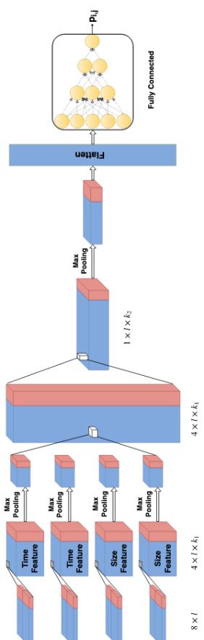
Potentially suitable techniques
Identifying exact packet-content matches
Statistical tests on the similarities of total incoming and outgoing stream
Average byte per flow
Average byte per hour
Time-correlation in activity levels
Port entropy anomalies
Training a correlation LSTM/CNN
Notes:
A common technique to detect stepping-stones is Watermarking, where a bitstring is actively embedded in the first packet stream by altering packet interarrival times. This watermark is then detected in the forwarded packet stream
Another popular technique is packet correlation, where similar packets that occur in both streams are matched through their size, timing, and other metadata, and accumulated as evidence of a relay.
Furthermore, some methods attempt to measure excessive round-trip-time in a connection, a characteristic of relayed connections.

